Slide 1
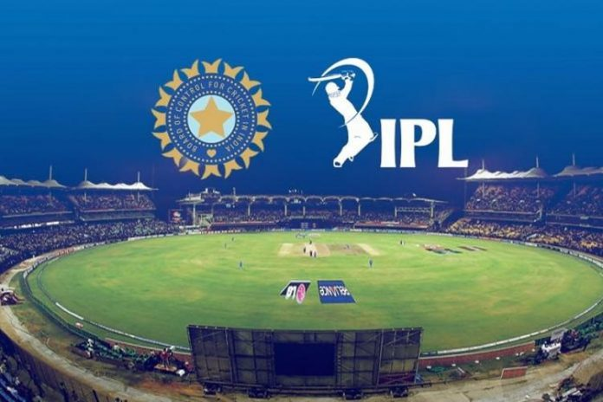
DATA ANALYSIS OF IPL MATCHES
SUBMITTED BY:
SACHIN GHANTEPPAGOL

Slide 2

Every team has a dream of winning the trophy ,but the dream becomes their goal and the goal is only achieved by planned action for unfavorable scenarios
DATA SOURCE
https://www.kaggle.com/manasgarg/ipl/tasks

Slide 3

Introduction
The Project gives the clear insights of the performance of teams in the Indian Premier League.
The dataset that is been used includes the data Upto 2017.
This includes the statistics of the runs scored by the batsman,wickets taken by the bowler and extra runs visuals etc.
Third Party Tie Up.
During Quarter 4, third party tie up can help to reduce the shipping cost.
Quarter Sales
Quarter 4 is proven to be the best quarter for sales so by focus on many offers can help increase sales.
Product Categories
Bundled product needs to be introduced for increase in sales of low selling products.
Segments
Non-Profitable customers can be looks upon to make them profitable.
Video Link

Slide 4
Objective 1 –
Total wins by each Team
Results and Analysis
In this chart it has been observed that Mumbai Indians has won the most of the matches,this makes it is the most successful ipl team.

Slide 5
Objective 2 –
Matches hosted at the venues
Results and Analysis
Most of the matches has been hosted at the Mumbai city
i.e 85 matches has been hosted at the Mumbai.

Slide 6
Objective 3 –
Team Wise Extra runs
Results and Analysis
In this Bar chart, we could see the total extra runs by each team.Here Mumbai Indians has awarded most extra runs.

Slide 7
Objective 4 –
Toss decisions
Results and Analysis
In this column chart,we could analyse that every time the team wins the toss , the team chooses to field at the most of the times and the teams has chosen to field rather to bat at first.

Slide 8
Objective 5 –
Runs scored by batsman.
Results and Analysis
In this pie chart,we could see the most runs are scored by Suresh raina,V Kohli,R Sharma respectively.Here we could see the share of the each batsman when compared to combined runs of all the batsman.

Slide 9
Objective 6 –
Bowler wise Extra runs.
Results and Analysis
In this pie chart,we can see the most of the extra runs awarded by the bowler.it is also observed that Umesh Yadav has given most extra runs.

Slide 10
Objective 7 –
Winner vs Toss winners
Results and Analysis
In this bar chart it is observed that in most of times the toss winner have won the match too . There is more probability that the toss winner will win the match.

Slide 11
Objective 8 –
Player of the match
Results and Analysis
In this pie chart, we could see the player wise player of the match. We could see the number of times the player has become the player of the match most of the times.

Slide 12
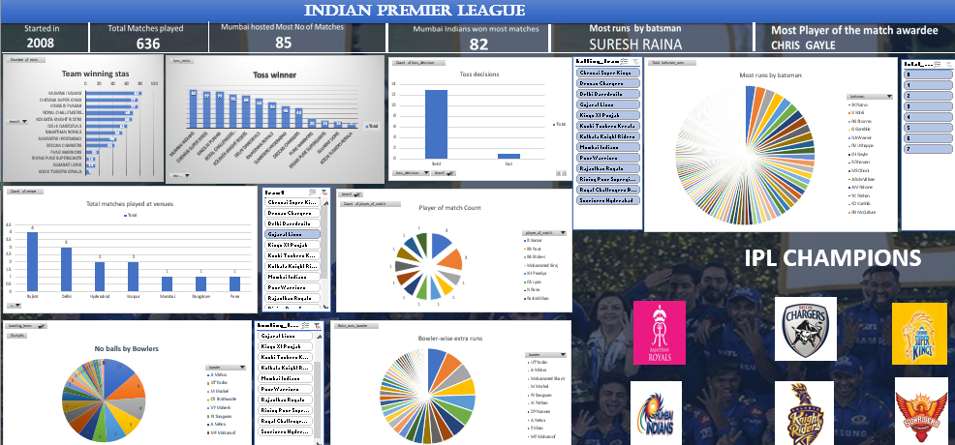
Dashboard

Slide 13
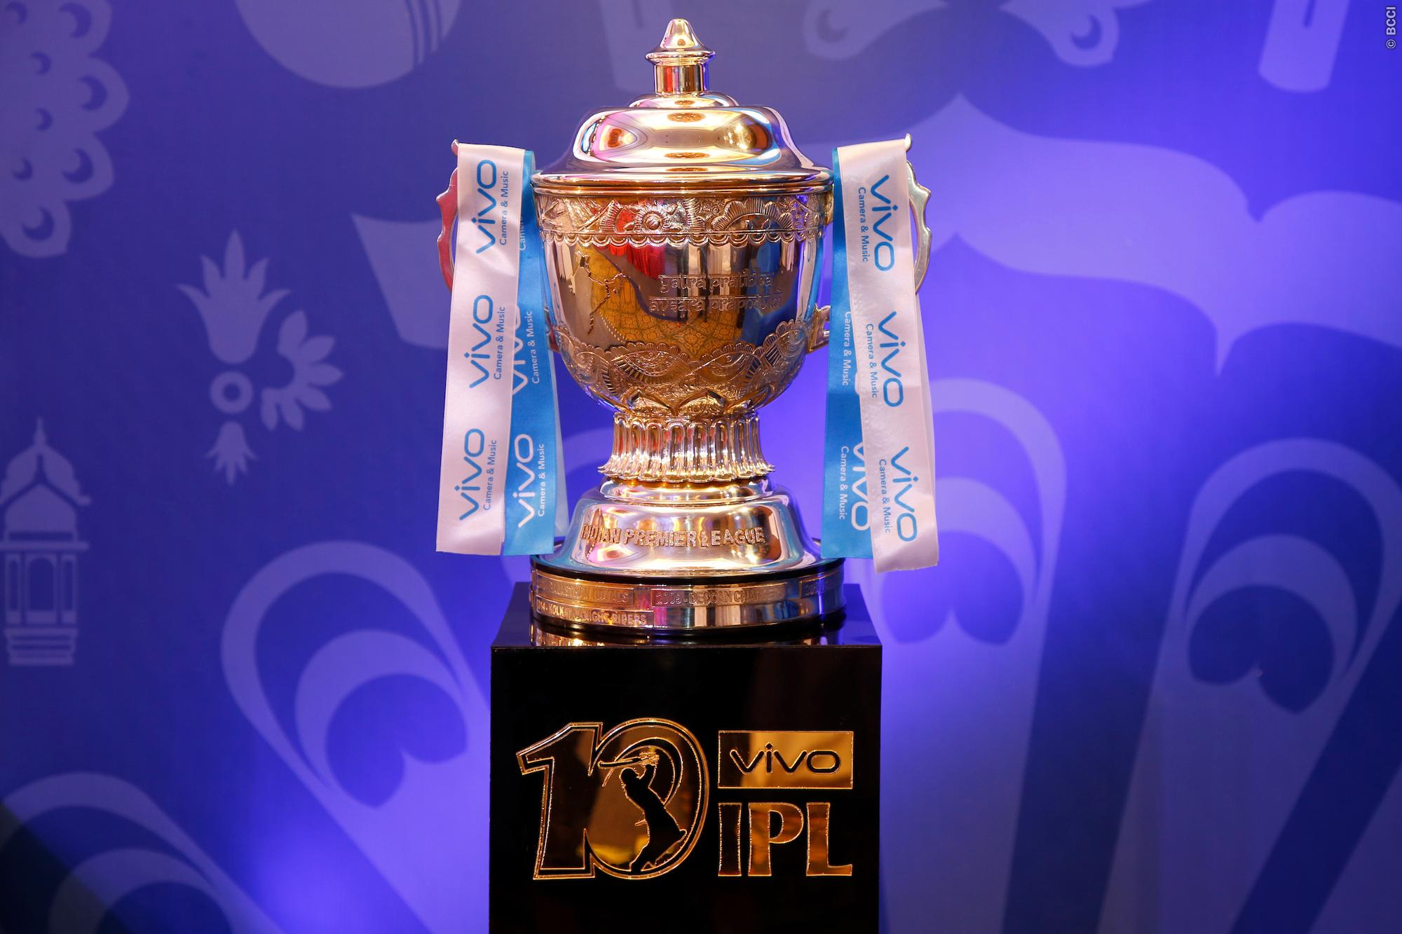
CONCLUSION
IPL Teams needs to look at each aspects such as toss decisions, wins at certain venues, most wickets-takers and most run scorers to win the trophy and become champions.

Slide 14
THANK YOU

